Slide 1
Intro to Programming
Taught by Devina Dhawan and James Traver

Slide 2
Why do you want to learn how to program?
Is it something you’ve been interested in?
Are you looking for a career change?
Do you want a better understanding of computer science?
What is your reason?

Slide 3
Scripts
Today you will learn to write your own applications in the form of scripts.
Scripts are applications that run on specific platforms.
They are interpreted – this means that the script runs in real time.
Other types of applications may be compiled.
Compiled applications are faster than interpreted scripts. This is because they are bundled and optimized.
Scripts typically are used for automation. They increase productivity when applied correctly.

Slide 4
Core Fundamentals of Programming
Every programming language behaves in a similar fashion.
Events can occur and can trigger actions.
Data is declared and used as variables.
You can use mathematics to run calculations.
You can make decisions based on logic.

Slide 5
What are events and how are they used?
Events are things that happen in an application.
Events have triggers.
When a user submits a button on a form, an event is triggered.
A photo loads on a webpage.
You can bind actions to these events.

Slide 6
How is logic used when programming?
You can use logic to make decisions in your applications.
They allow you to set conditions.
If something does not meet criteria you may perform an action.
Else you may perform another action.
If (yourAge >= 21) you may buy alcohol else sorry, you may drink o’douls

Slide 7
Operators are the actions of mathematics
Addition, subtraction, multiplication, and division are represented as symbols known as operators
+ - = < / *
They follow the order of operations
Operators are symbols.
Total price = Pre Tax Total + (Tax Rate * Pre Tax Total)

Slide 8
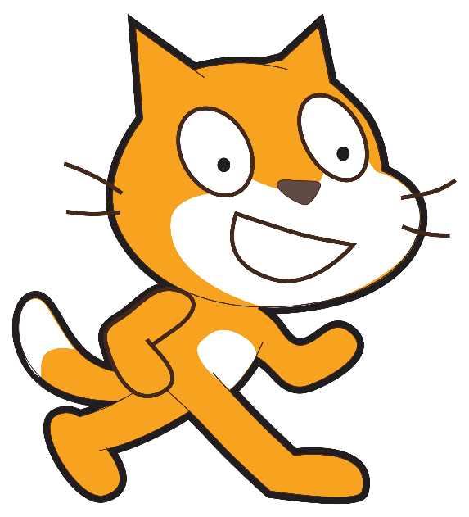
So what is MIT’s Scratch?

Slide 9
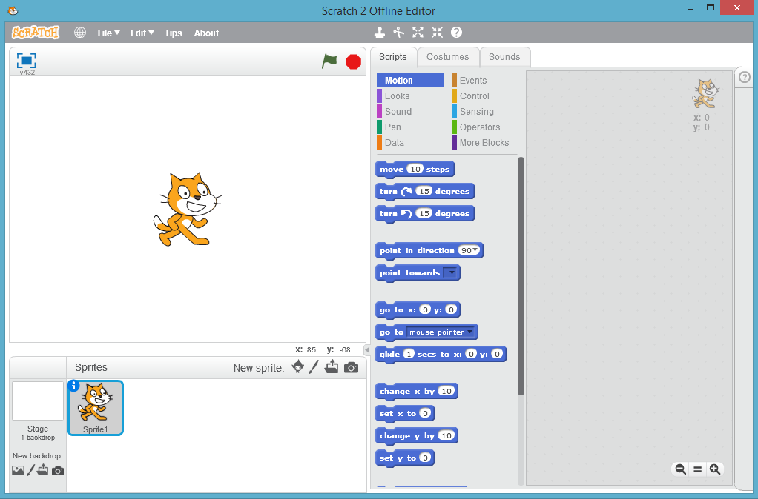
Scratch is an IDE
IDE: integrated development environment. A full suite of tools in an environment that allows you to write your own applications.

Slide 10
Let’s get started!

